Slide 1
University of Diyala
College of Engineering
Department of Architecture
1ST Stage
2018 – 2019
Lecture_ 07

Slide 2
Form

Slide 3
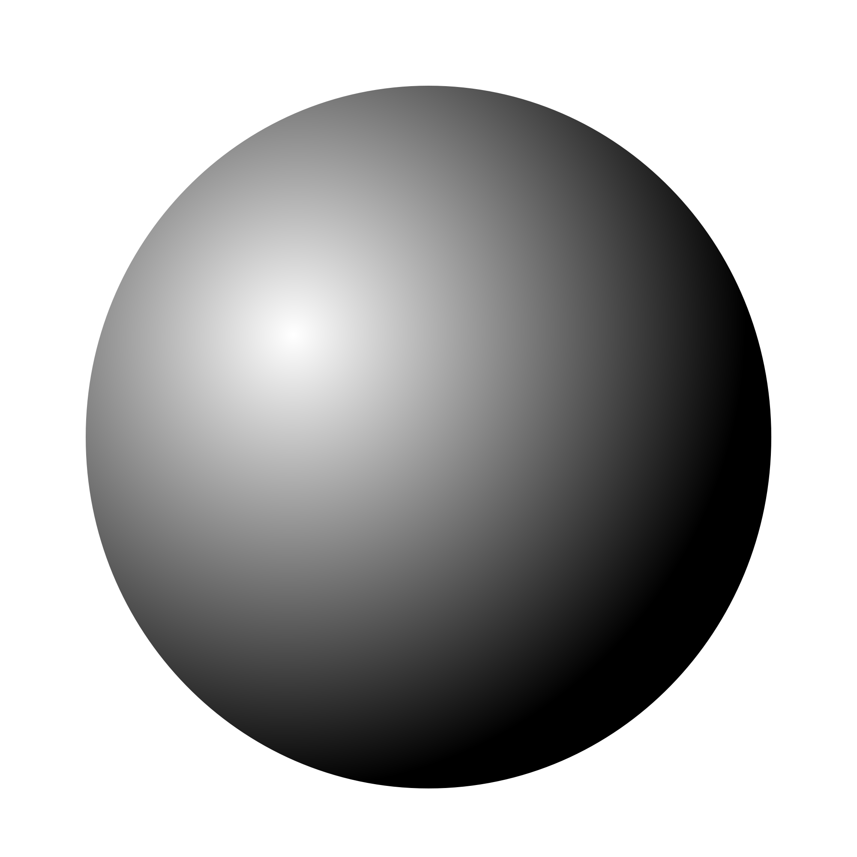
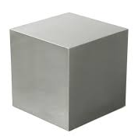
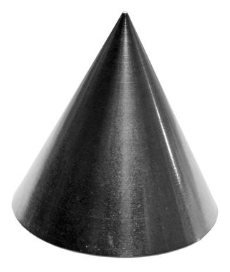
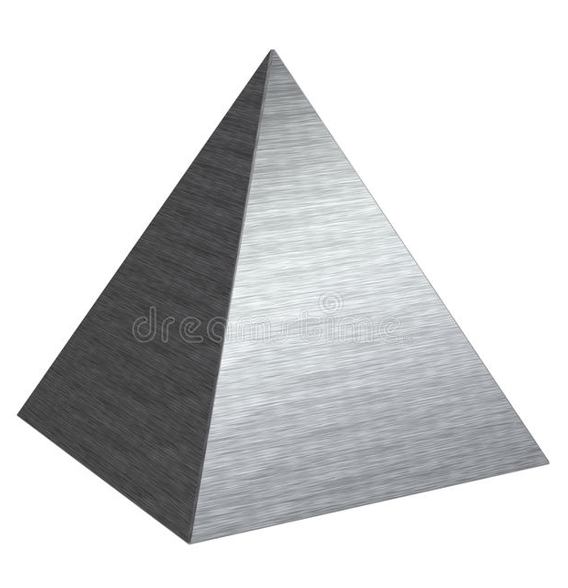
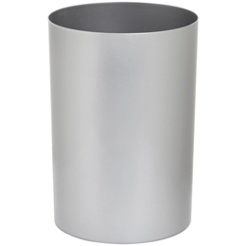
PRIMARY SOLIDS
Sphere
Cylinder
Cone
Cube
Pyramid

Slide 4
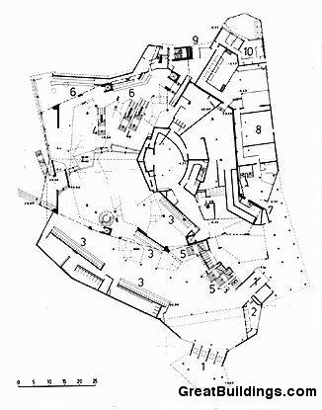
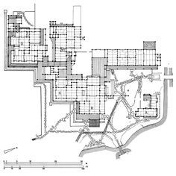
REGULAR & IRREGULAR FORMS
Irregular Forms of irregular composition:
Irregular Composition of Regular Forms:

Slide 5
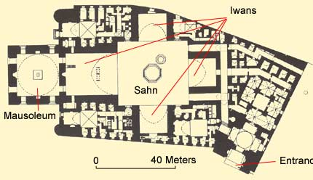
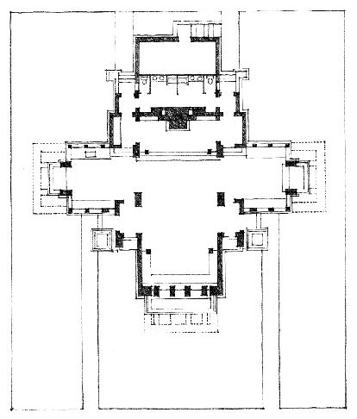
Regular Forms within an Irregular Composition:
Regular Composition of Regular Forms:

Slide 6
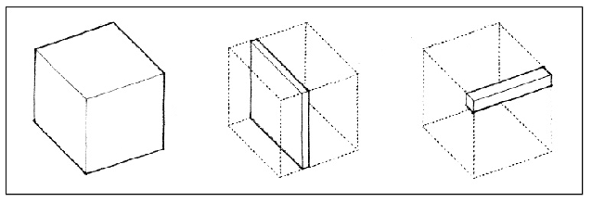
TRANSFORMATION OF FORM
Dimensional Transformation

Slide 7
Subtractive Transformation

Slide 8
Additive Transformation

Slide 9
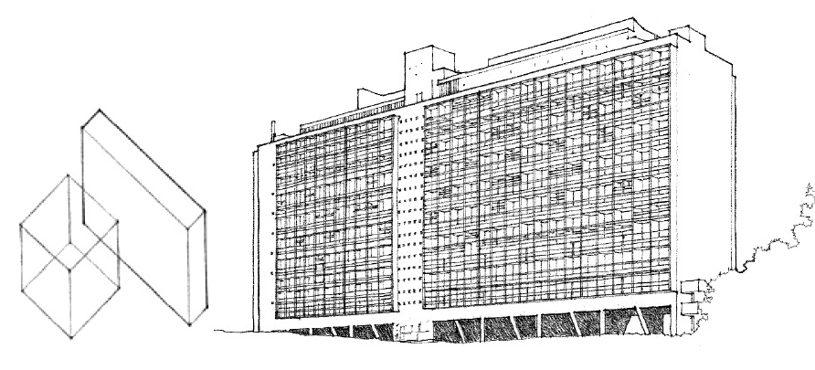

Slide 10
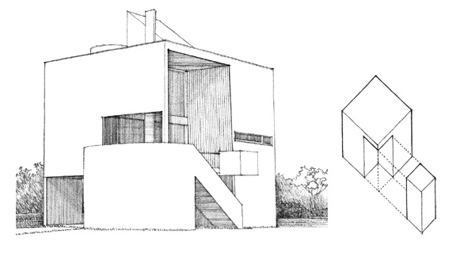

Slide 11
